Slide 1

Quantum Compiler Optimization
Circuit Compilation & Simplification
Notes:
Hi everyone,

Slide 2
Quantum Circuit Compilation
Original
Quantum
Circuit
Target
Gate
Set
Simplified
Circuit
Device
Decomposition
Rules
Gate fusion,
Gate cancellation,
Circuit routing
Etc.
Wave Paulse
Generator
(analog signal)
Notes:
Quantum circuit as a high level human readable notation, it cannot directly be executed by machines, since real machines can only execute a sequence of analog signal from the wave generators that controls the actual device. Moreover, the executable gate sets are usually limited due to hardware limitation.
(go through the diagram)
So today I will introduce a few technique about how to simplify a quantum circuit inside this part,
that can help cancel out some part of the circuit while proving the equivalence of compiled circuit and the original
circuit.

Slide 3
Pattern Match & Term Rewrite
Manipulating Symbolic expressions
Notes:
The most straight forward way to simplify quantum circuits is by performing pattern matching directly. I happened to find this technique this term in order to write a program that can do the assignment for me. We will use this technique over and over again in the following part, so I will introduce this briefly first.

Slide 4
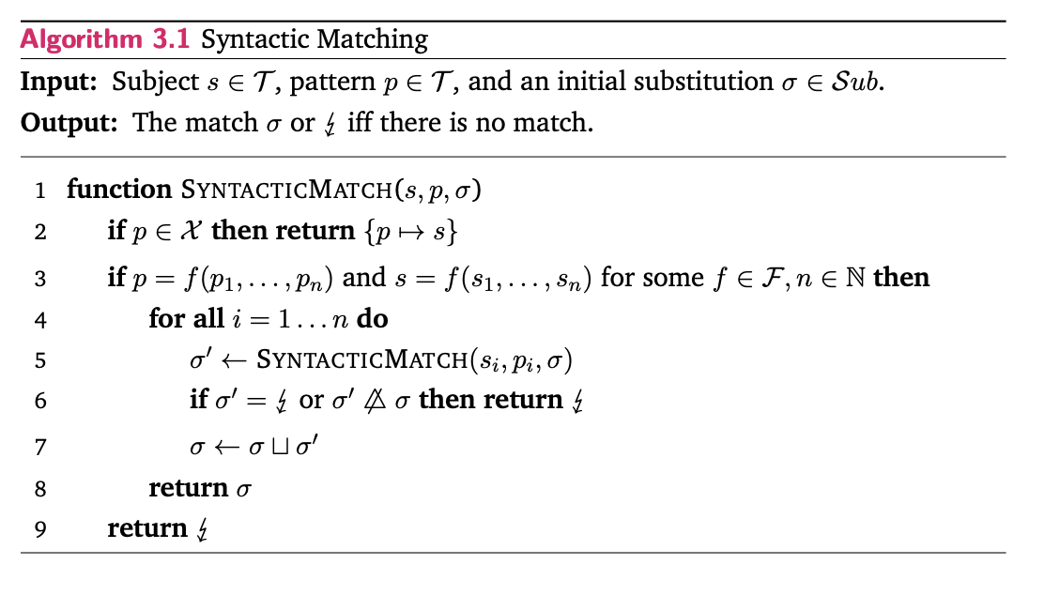
Symbolic Simplification 101
a * b + sin(pi)
+
*
Sin(pi)
a
b
Notes:
To give you an impression about what does this do, let’s start from a symbolic expression first.
first, we can write this symbolic expression as a tree, or in more formal word, an abstract syntax tree
Then the pattern match is that given a smaller tree, we try to find a similar tree in the large one. As for a tree, this is just tree search, which has complexity O(M) where M is the number of nodes
If we find the small tree, we return the node marked as variable

Slide 5
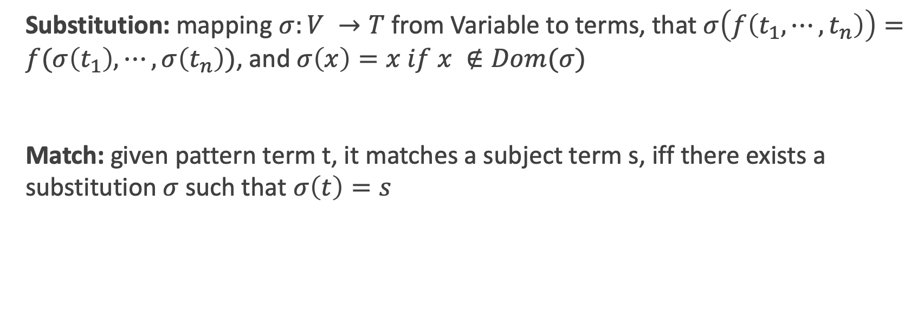
Definition
Substitution: mapping $σ:V →T$ from Variable to terms, that $σ\left(f\left(t_{1}, ⋯,t_{n}\right)\right)=f(σ\left(t_{1}\right),⋯,σ\left(t_{n}\right))$, and $σ\left(x\right)=x if x ∉Dom(σ)$
Match: given pattern term t, it matches a subject term s, iff there exists a substitution $σ$ such that $σ\left(t\right)=s$
Notes:
A more formal definition can be written by defining what is substitution. A substitution is a mapping from variable to terms, satisfy this condition where f is some random function, and t are the terms as input. It replace the variable that in the set Dom to its corresponding term.
So we say it is a match, when given term t, it matches a subject term s, if and only if there exists a substitution sigma that by applying it, we get the exact the same thing as our original term.

Slide 6
Circuit Optimization/Simplification
Pattern Match
Rewrite
(Matched)
Terms
Target
Gate
Set
Simplified
Circuit
Can be simplified
Yes
No
Notes:
Then we can do the most straightforward thing: by finding some equivalent circuit in advance as templates, we perform some pattern match algorithm on the circuit diagram, and replace them. By Gottsman Knill theorem, we know that at least we should be able to remove all the internal Cliffords in principal.

Slide 7
Graph Pattern Match?
No
(Exact) Graph Pattern Match is subgraph isomorphism problem
Subgraph isomorphism problem is NP-complete (Stephen A Cook. et al STOC’ 71)
Notes:
But what kind of pattern matching algorithm should be use? The quantum circuit itself, naively, can be interpreted as a graph with some edges and nodes. So can be do graph pattern match on the circuit then?
The answer is unfortunately no, since in general finding the exact graph pattern is a subgraph isomorphism problem, which has been proved to be NP-complete.

Slide 8
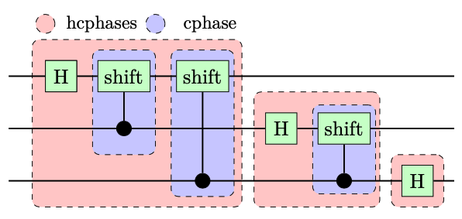
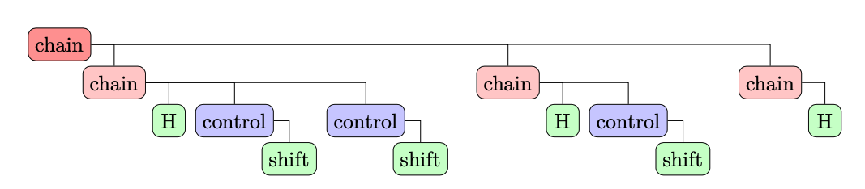
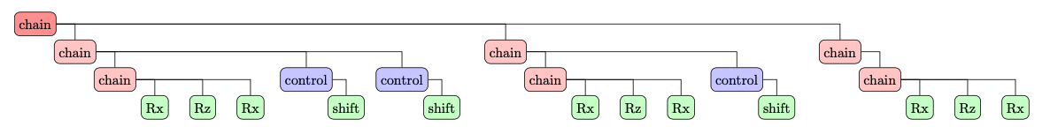
Quantum Circuit as Expression
parse
decomposition
Notes:
But let’s think about what is a quantum circuit: it is just a representation of matrix multiplications and Kronecker product. As what we have already introduced, we can write this as trees as well by adding some extra nodes.
This form is much more elegant, and you can find the decomposition is just grow the tree, and we can use the syntactic pattern match algorithm, which is only poly(M) where M is the number of gates ( leaf nodes)

Slide 9
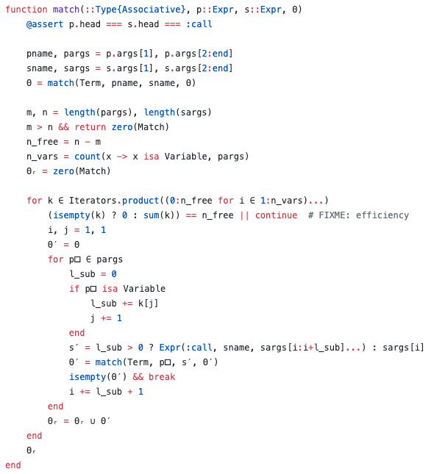
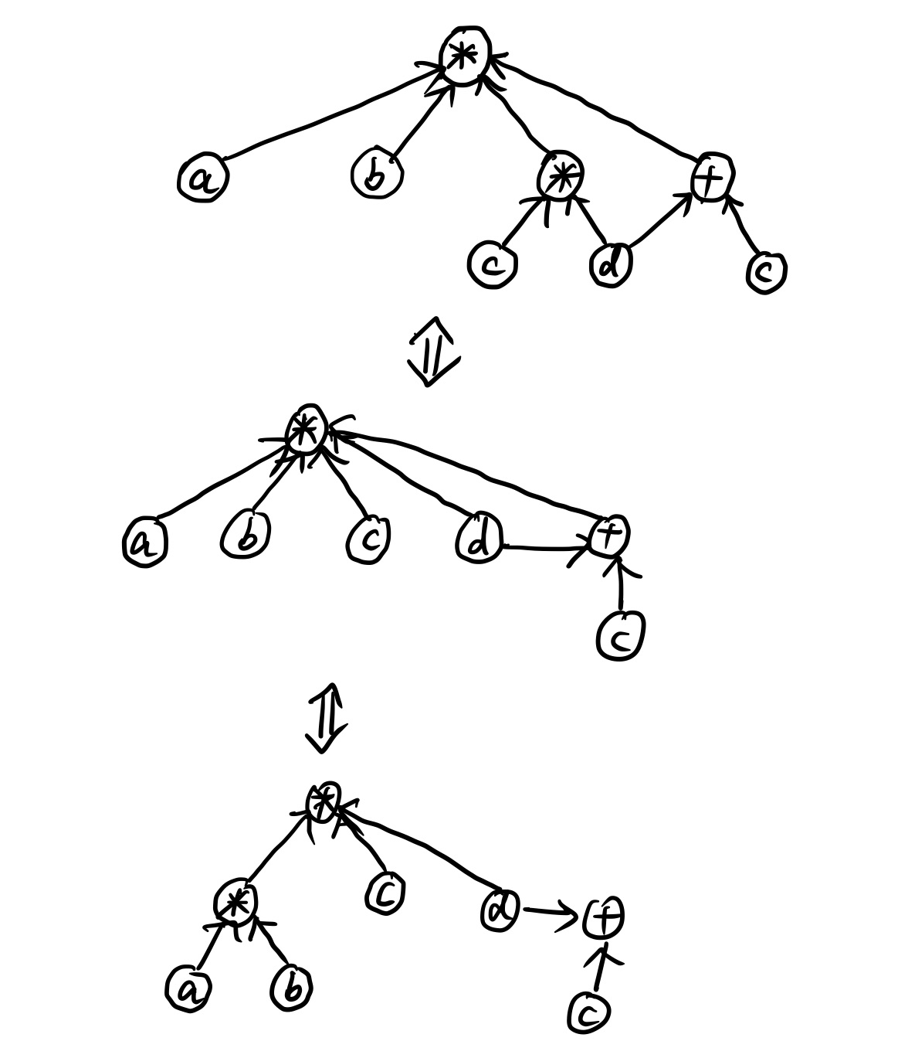

Associative Match $O(\left(\begin{matrix}N \\ m\end{matrix}\right))$
a * b * (c * d) * (d + c)
Notes:
However, this is not perfect. There are a lot associate terms in the matrix multiplication and Kronecker product, and we should match them as well. This add an extra combinatorial factor to the complexity.

Slide 10
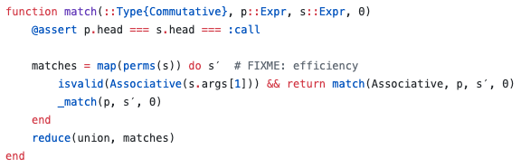
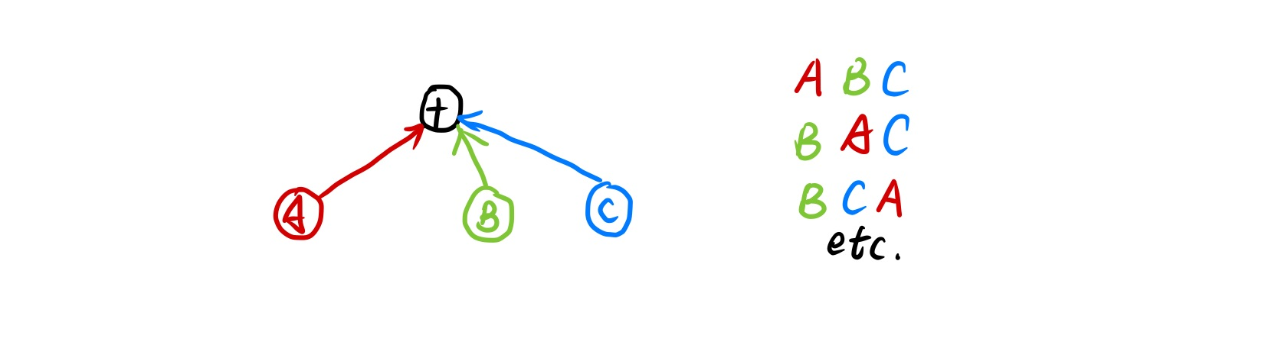
Communitive Match O(N!)
A + B + C + (A + D) + (A + D+ D+ B)
1. https://github.com/Roger-luo/Sym.jl
2. https://github.com/QuantumBFS/YaoBlocks.jl/pull/78
Notes:
Besides, a lot quantum gates are communitive with each other, the most obvious case is when two quantum gates do not share any wires. We also need to search all the communitive patterns, which adds another N factorial factor to the complexity.
I implemented these pattern matching algorithm here one as a symbolic engine and the other is a patch. However, they are not good in general, and are very slow. And by considering associative and communitive operations, the algorithm is no longer polynomial. Thus is there a polynomial algorithm for this?

Slide 11
Circuit Optimization/Simplification
Intermediate
Representation
Pattern Match
Rewrite
(Matched)
Terms
Target
Gate
Set
Simplified
Circuit
Can be simplified
Yes
No
Notes:
a cleverer approach is to use a new representation that has some nice mathematical properties, so we could manipulate in an easier and efficient way. For example, what if we can have a graph like representation, but do not contain any loops? This will make pattern match problem on the graph much simpler!
In classical programming language or compiler optimization, this is called intermediate representation, which means we convert to this representation temporarily only for the compiler to learn and transform the program, after we process the program we will compile it back to the some other forms to actually execute the program.

Slide 12
Tensor Network
A quick guide
Notes:
Before we introduce other techniques, let me introduce the tensor network notation first. I won’t do this very detail, but only some basics.

Slide 13
From Tensors to Networks
Vector
Matrix
Cube

Slide 14
ZX Diagram & Calculus
A graphic representation of quantum circuits
Notes:
One mature approach is called ZX calculus, which comes from tensor network notation.
(draw a matrix product state on black board)

Slide 15
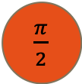
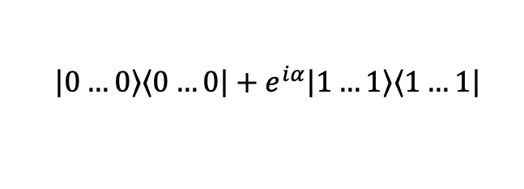
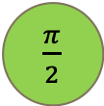

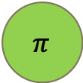
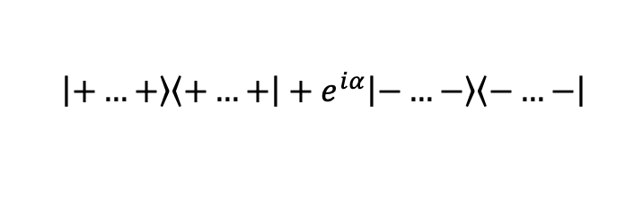

Semantics
Z spider
$$\left|0\right.…\left.0\right\rangle \left\langle 0\right.…\left.0\right|+e^{iα}\left|1\right.…\left.1\right\rangle \left\langle 1\right.…\left.1\right|$$
⍺
$π$
Z
$π$
X Spider
$$\left|+\right.…\left.+\right\rangle \left\langle +\right.…\left.+\right|+e^{iα}\left|−\right.…\left.−\right\rangle \left\langle −\right.…\left.−\right|$$
X
⍺
H
Hadamard gate
$\frac{π}{2}$
$\frac{π}{2}$
$\frac{π}{2}$

Slide 16
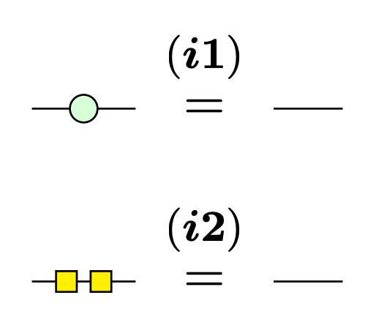
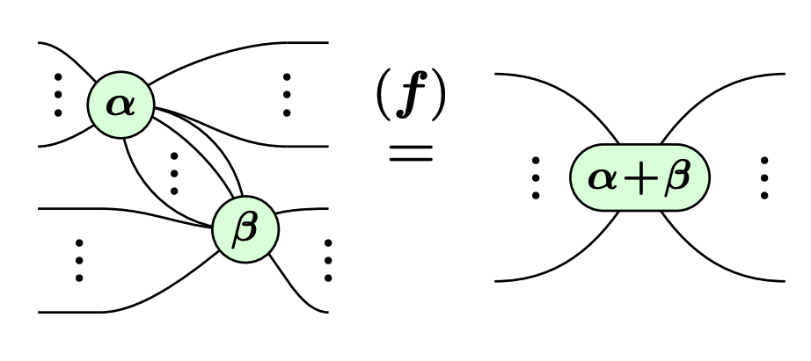
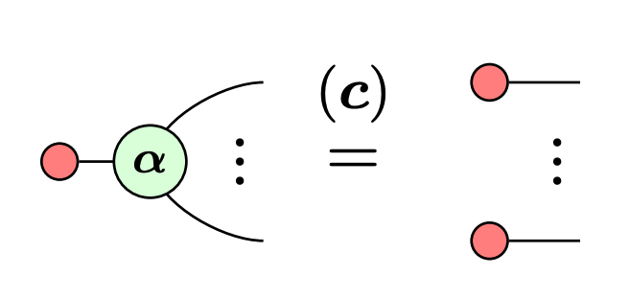
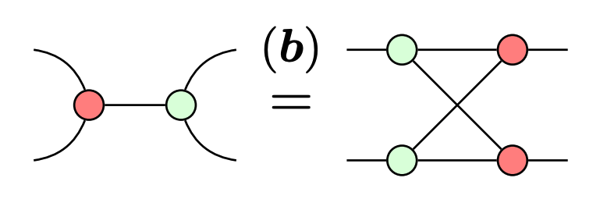
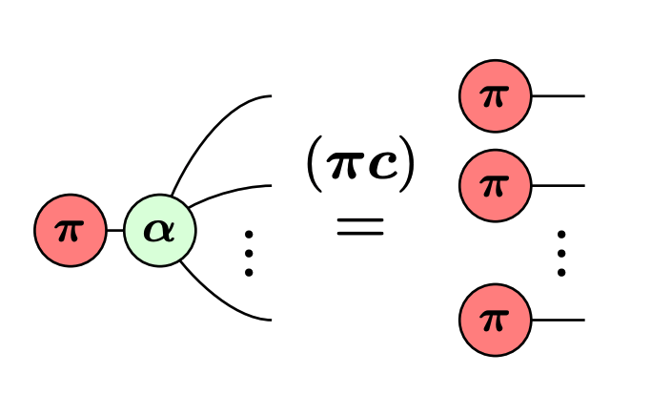
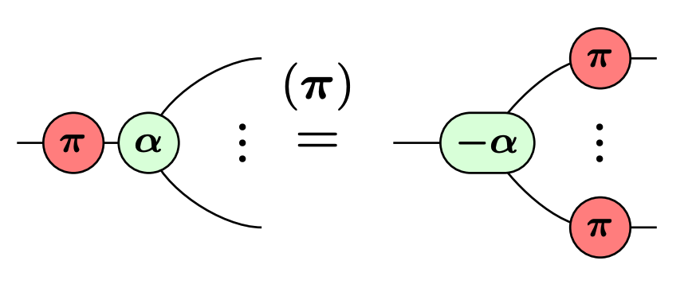
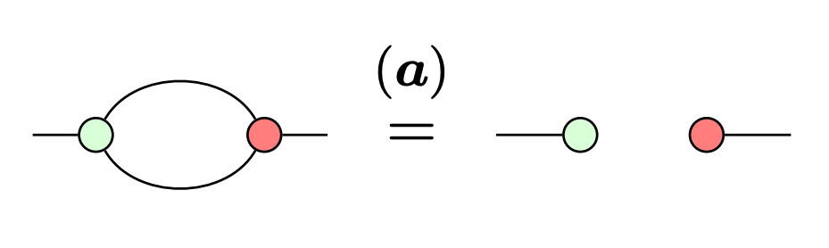
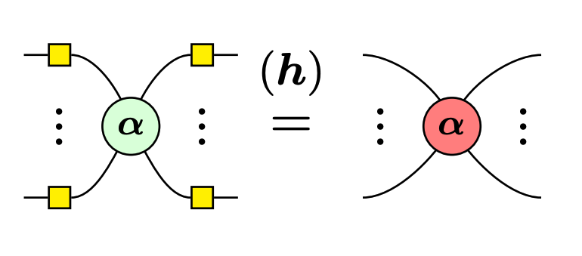
Straightforward Rules

Slide 17
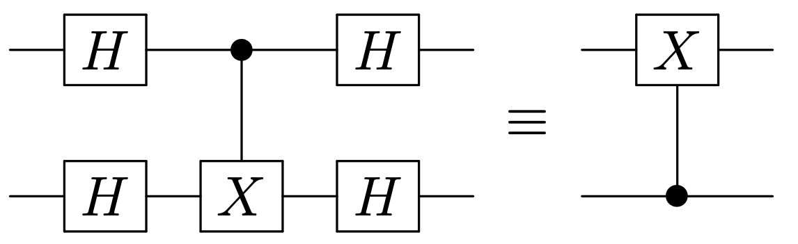
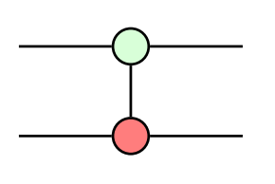
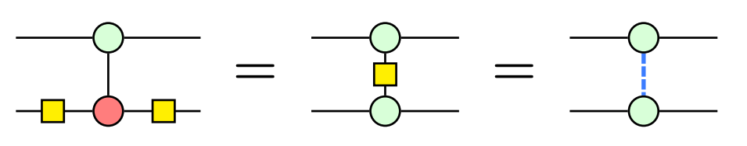
Straightforward Rules
CZ
CNOT

Slide 18
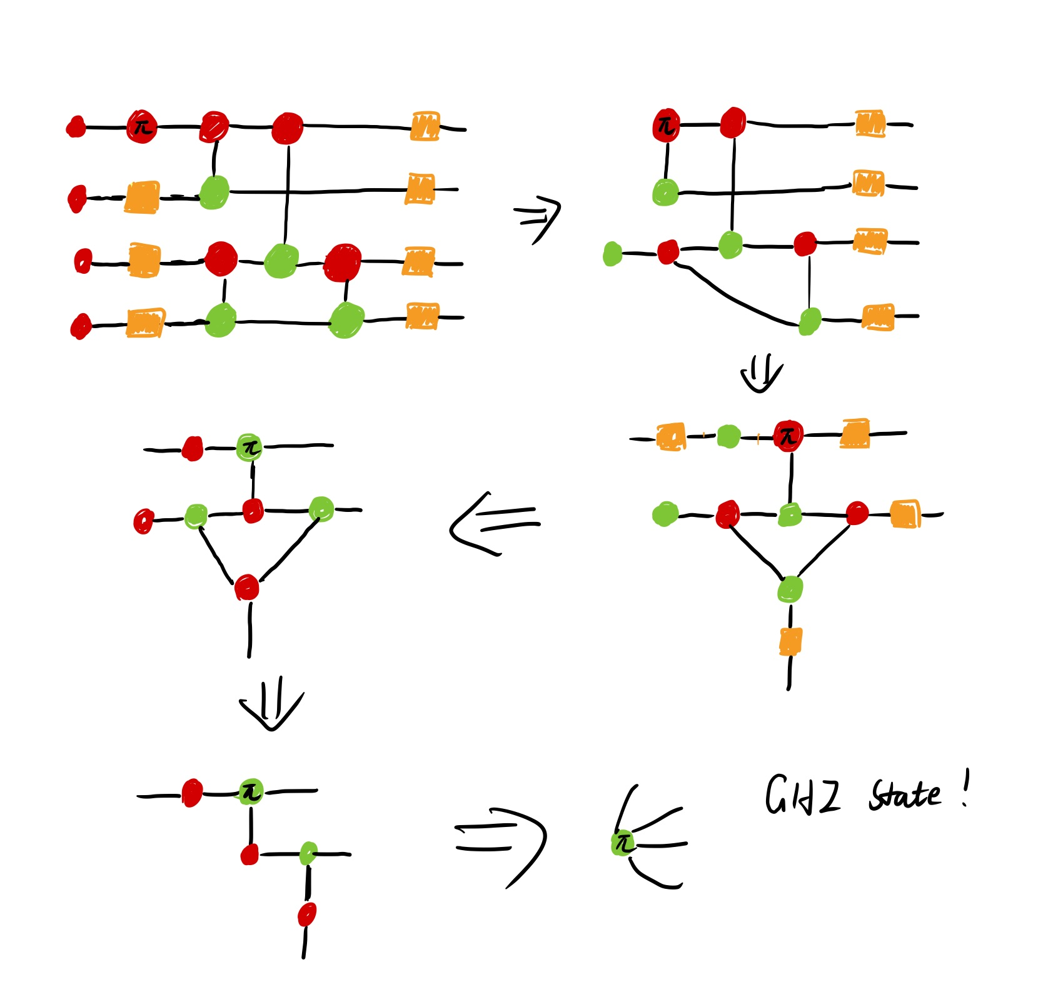
Constructing GHZ state
Notes:
I wrote up an example here for proving this circuit will output a GHZ state, but due to time limit, I won’t talk about how to do it in detail.

Slide 19
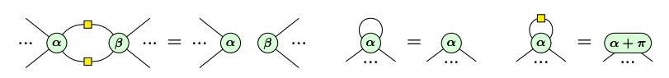
Canonicalize: graph-like ZX-diagram
Notes:
One thing we would like to do is to remove the freedom of this representation as much as possible, since if we want to make our simplification efficient this means we should limit our search space to a small one. Thus now we introduce the graph-like ZX-diagram which limits the entire diagram on Z basis.
All spiders are Z-spiders
Z-spiders are only connected via Hadamard edges
There are no parallel Hadamard edges or self-loops
Every input or output is connected to a Z-spider and every Z-spider is connected to at most one input or output

Slide 20
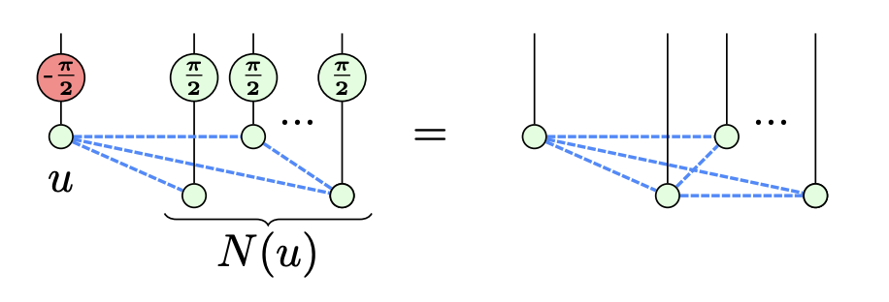
Graph State
A quantum state that constructed by CZ gate and each CZ gate represents an edge in the graph.
Definition: Local Complementation Let G be a graph and let u be a vertex in the graph.
The local complement according to u, written as G ★ u is a graph which has the same
vertices as G, but the sub-graph on its neighrbors is a complement graph of the original.
Notes:
Graph state we are talking about here are quantum state that can be mapped to a simple graph. Graph states are equivalent by a factor under local complement, and by performing local complement, we will show there can be two rules to let you remove nodes from the graph

Slide 21
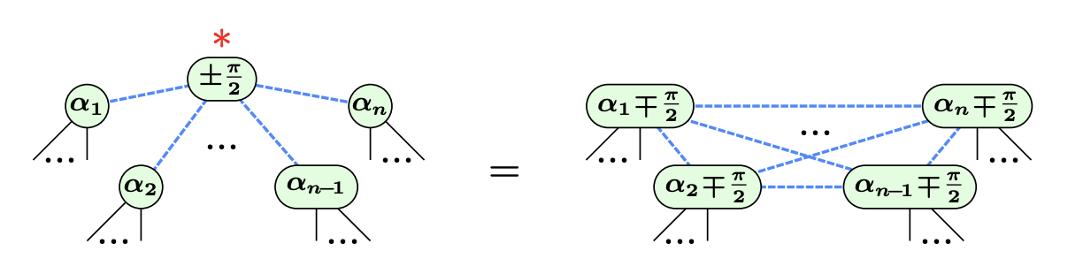
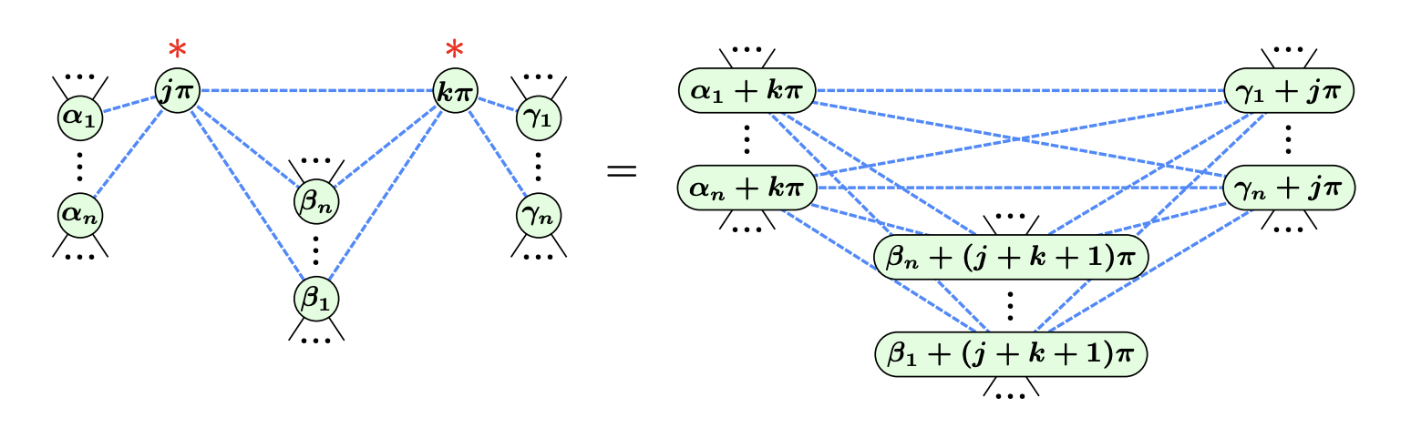
Two more rules
Local Complementation
Graph Pivoting
Notes:
Here graph pivoting means performing local complement twice on the connected nodes in this graph, which removes both of the nodes and transfer the phase to other nodes in the end. And how do we apply these rules? We reuse the exact pattern matching algorithm we introduced in the beginning.

Slide 22
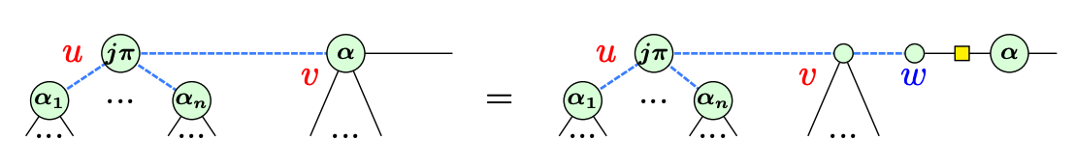
Theorem: exists a terminating procedure to turn any graph-like ZX diagram to another ZX-diagram which does not contain
Interior proper Clifford spiders
Adjacent pairs of interior Pauli spiders
Interior Pauli spiders adjacent to a boundary spider
Proof
1. Remove marked Clifford
2. Remove adjacent pair of interior Pauli
3. Remove Interior Pauli adjacent to boundary
Notes:
We first apply the local complement rule to every marked interior Clifford spider to remove them, then apply the graph pivoting rule to remove the adjacent pair of interior Pauli, in the end, to remove adjacent Pauli to boundary, we will make up a graph by inserting an identity and a pair of Hadamard then apply the graph pivoting rule.

Slide 23
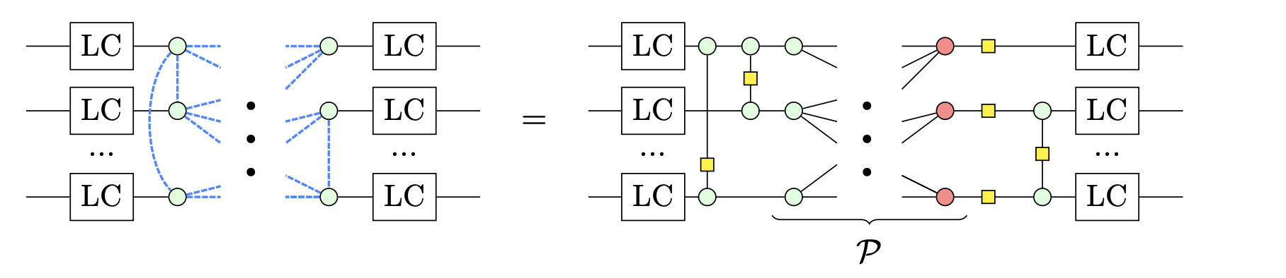
Extract The Circuit
Notes:
After we do the simplification procedure, we will get a diagram where the local complement. By redo the CZ part we will get a classical parity function that can be realized

Slide 24
Outlook
How general quantum program (with classical control flows) can be compiled and modified?
Is it possible to perform more hardware related simplification task? (e.g reducing long range interactions)
Pattern Match on Quantum Circuits with Transformer model (arXiv: 1912.01412)

Slide 25
Quon
A 3d topological language for quantum information
Notes:
As we see, ZX calculus basically comes from tensor network notations, and it is limited in a certain algebraic structure that requires the assistance of other form of calculus. It is natural to ask, if there is more elegant and powerful representation to express this task? The answer is certainly yes.
The quon representation decompose a qubit basis into four basis each basis represents a string

Slide 26
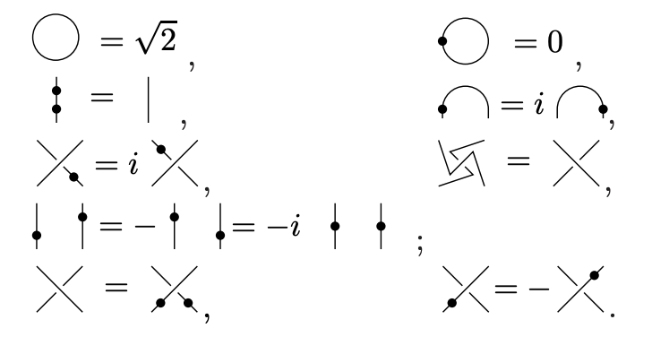
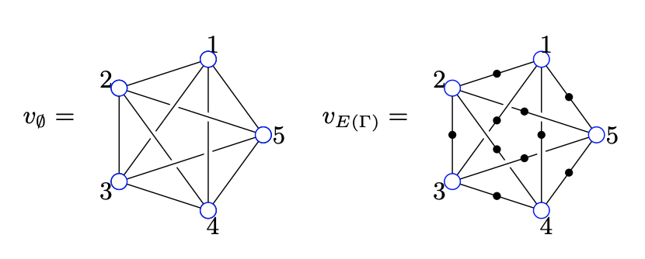
Semantics

